Slide 1
Informed search algorithms

Slide 2
Local search algorithms
In many optimization problems, the path to the goal is irrelevant; the goal state itself is the solution
State space = set of "complete" configurations
Find configuration satisfying constraints, e.g., n-queens
In such cases, we can use local search algorithms
keep a single "current" state, tries to improve it

Slide 3
Iterative Improvement Search
Another approach to search involves starting with an initial guess at a solution and gradually improving it until it is a legal/optimal one.
Some examples:
Hill climbing
Simulated annealing
Constraint satisfaction
Notes:
‹#›

Slide 4
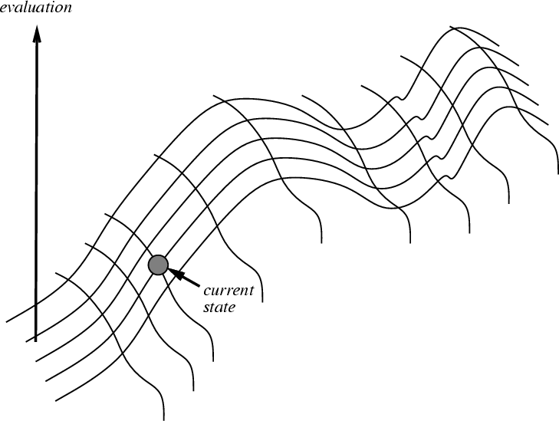
Hill Climbing on a Surface of States
Height Defined by Evaluation Function
Notes:
‹#›

Slide 5
Hill Climbing Search
If there exists a successor s for the current state n such that
h(s) < h(n)
h(s) ≤ h(t) for all the successors t of n,
then move from n to s. Otherwise, halt at n.
Looks one step ahead to determine if any successor is better than the current state; if there is, move to the best successor.
Similar to Greedy search in that it uses h, but does not allow backtracking or jumping to an alternative path since it doesn’t “remember” where it has been.
Corresponds to Beam search with a beam width of 1 (i.e., the maximum size of the nodes list is 1).
Not complete since the search will terminate at "local minima," "plateaus," and "ridges."
Notes:
‹#›

Slide 6
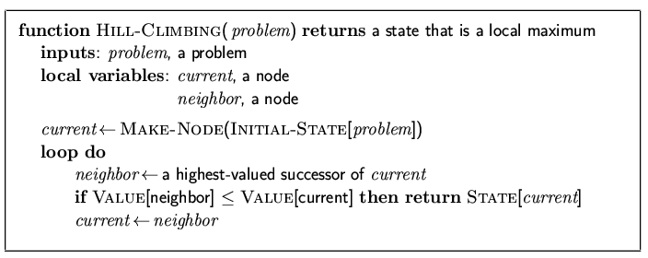
Hill-climbing search
"Like climbing Everest in thick fog with amnesia"

Slide 7
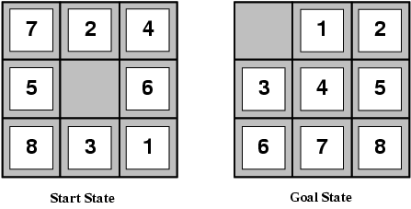
Example: The 8-puzzle
states? locations of tiles
actions? move blank left, right, up, down
goal test? = goal state (given)
path cost? 1 per move
[Note: optimal solution of n-Puzzle family is NP-hard]

Slide 8
Admissible heuristics
E.g., for the 8-puzzle:
h₁(n) = number of misplaced tiles
h₂(n) = total Manhattan distance
(i.e., no. of squares from desired location of each tile)
h₁(S) = ?
h₂(S) = ?

Slide 9
Admissible heuristics
E.g., for the 8-puzzle:
h₁(n) = number of misplaced tiles
h₂(n) = total Manhattan distance
(i.e., no. of squares from desired location of each tile)
h₁(S) = ? 8
h₂(S) = ? 3+1+2+2+2+3+3+2 = 18

Slide 10
Dominance
If h₂(n) ≥ h₁(n) for all n (both admissible)
then h₂ dominates h₁
h₂ is better for search
Typical search costs (average number of nodes expanded):
d=12 IDS = 3,644,035 nodes A*(h₁) = 227 nodes A*(h₂) = 73 nodes
d=24 IDS = too many nodes A*(h₁) = 39,135 nodes A*(h₂) = 1,641 nodes

Slide 11
Hill Climbing Example
2
8
3
1
2
3
start
1
6
4
h = -4
goal
8
4
h = 0
7
5
7
6
5
-5
-5
-2
2
8
3
1
2
3
1
4
h = -3
8
4
h = -1
7
6
5
7
6
5
-3
-4
2
3
2
3
1
8
4
1
8
4
h = -2
7
6
5
7
6
5
h = -3
-4
f(n) = -(number of tiles out of place)
Notes:
‹#›

Slide 12
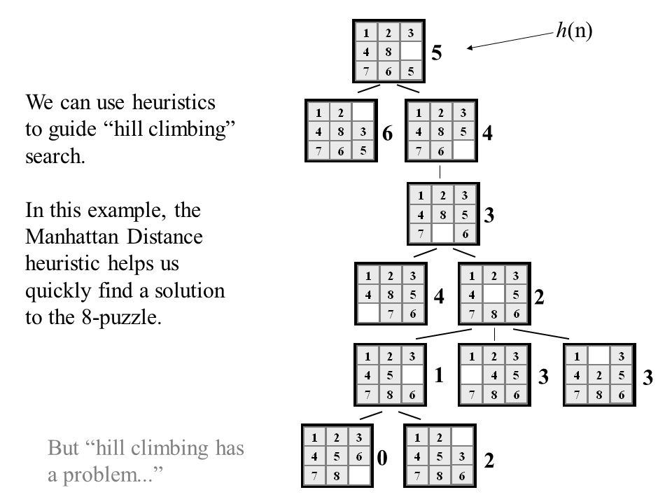
Hill Climbing Example
Hill climbing with minimization goal:
Here, the objective function is
min f Where, f = h(n)=(manhattan distance)

Slide 13
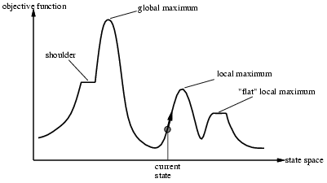
Drawbacks of Hill-climbing search
Problem: depending on initial state, can get stuck in local maxima

Slide 14
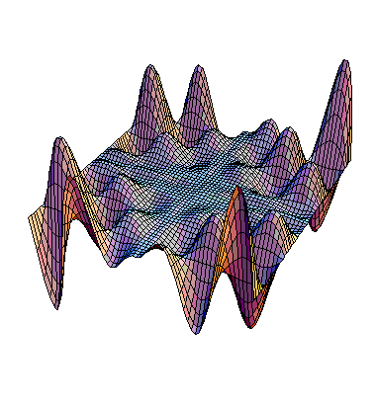
Exploring the Landscape
local maximum
Local Maxima: peaks that aren’t the highest point in the space
Plateaus: the space has a broad flat region that gives the search algorithm no direction (random walk)
Ridges: flat like a plateau, but with drop-offs to the sides; steps to the North, East, South and West may go down, but a step to the NW may go up.
plateau
ridge
Image from: http://classes.yale.edu/fractals/CA/GA/Fitness/Fitness.html
Notes:
‹#›

Slide 15
Example of a Local Optimum
1
2
5
7
4
f = -7
start
move
up
goal
8
6
3
1
2
5
1
2
3
8
7
4
8
4
f = 0
move
right
6
3
7
6
5
f = -6
1
2
5
Local Maxima
8
7
4
f = -7
f = -(manhattan distance)
6
3
Plateaus
Notes:
‹#›

Slide 16

Example: n-queens
Put n queens on an n × n board with no two queens on the same row, column, or diagonal

Slide 17
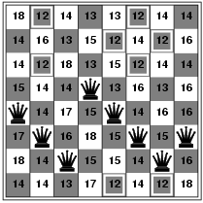
Hill-climbing search: 8-queens problem
h = number of pairs of queens that are attacking each other, either directly or indirectly
h = 17 for the above state

Slide 18
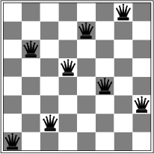
Hill-climbing search: 8-queens problem
A local minimum with h = 1

Slide 19
Remedies of Hill Climbing Search
Problems: local maxima, plateaus, ridges
Remedies:
Random restart: keep restarting the search from random locations until a goal is found.
Problem reformulation: reformulate the search space to eliminate these problematic features
Simulated Annealing
Some problem spaces are great for hill climbing and others are terrible.
Notes:
‹#›

Slide 20
Simulated Annealing
Simulated annealing (SA) exploits an analogy between the way in which a metal cools and freezes into a minimum-energy crystalline structure (the annealing process) and the search for a minimum [or maximum] in a more general system.
SA can avoid becoming trapped at local minima.
SA uses a random search that accepts changes that increase objective function f, as well as some that decrease it.
SA uses a control parameter T, which by analogy with the original application is known as the system “temperature.”
T starts out high and gradually decreases toward 0.
Notes:
‹#›

Slide 21
Simulated annealing
Idea: escape local maxima by allowing some "bad" moves but gradually decrease their frequency
1. C = C_{init} // here, C is the current state and C_{init} is the initial state
2. For T = T_{max} to T_{min} // here,T is the control temperature for annealing
3. E_{C} = E(C) // here, E_{C} is the Energy i.e. utility or goodness value of state C
4. N = Next (C) // Here, N is next state of current state C
5. E_{N} = E(N) // here, E_{N} is the Energy i.e. utility or goodness value of state N
6. ΔE = E_{N} – E_{C} //Here, ΔE is the Energy difference
7. If (ΔE > 0)
8. C=N
9. Else if (e^{ΔE / T}> rand(0,1)) // Suppose, ΔE = -1, T_{max} = 100 and T_{min} = 2
C=N // e^{ΔE / T} = 0.99 for T_{max} = 100
11. End // e^{ΔE / T} = 0.60 for T_{min} = 2

Slide 22
Simulated Annealing (cont.)
f(s) represents the quality of state n (high is good)
A “bad” move from A to B is accepted with a probability
P(move_{A→B}) ≈ e^{( f (B) – f (A)) / T}
(Note that f(B) – f(A) will be negative, so bad moves always have a relatively probability less than one. Good moves, for which f(B) – f(A) is positive, have a relative probability greater than one.)
The higher the temperature, the more likely it is that a bad move can be made.
As T tends to zero, this probability tends to zero, and SA becomes more like hill climbing
If T is lowered slowly enough, SA is complete and admissible.
Notes:
‹#›

Slide 23
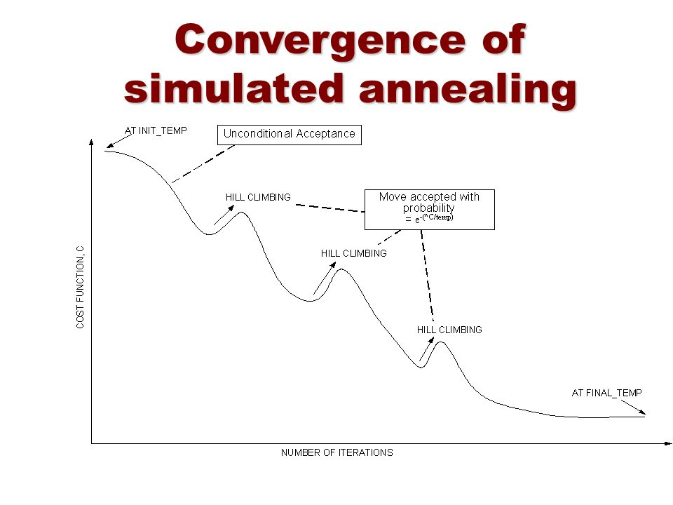

Slide 24
Properties of simulated annealing search
One can prove: If T decreases slowly enough, then simulated annealing search will find a global optimum with probability approaching 1
Widely used in VLSI layout, airline scheduling, etc

